Slide 1
MODBUS dataset
Normal vs Attacks Classification

Slide 2
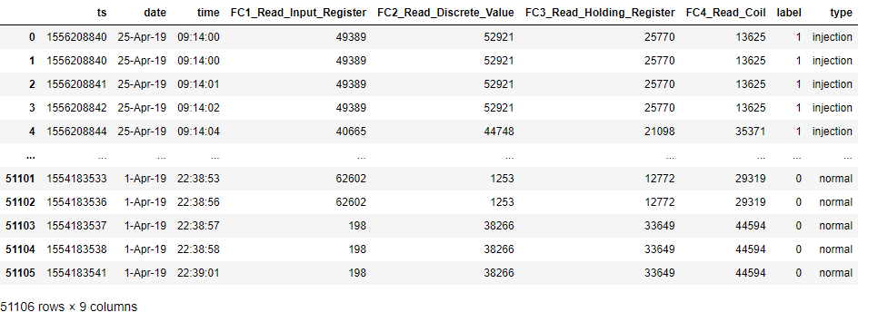

Slide 3
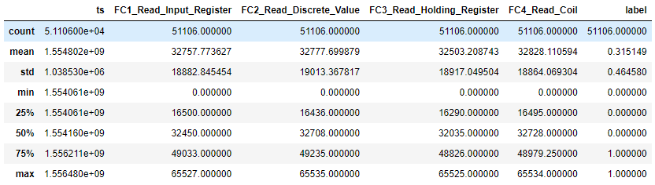

Slide 4
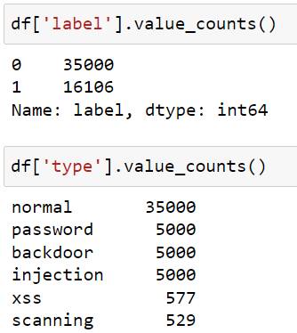
Messages and attacks count

Slide 5
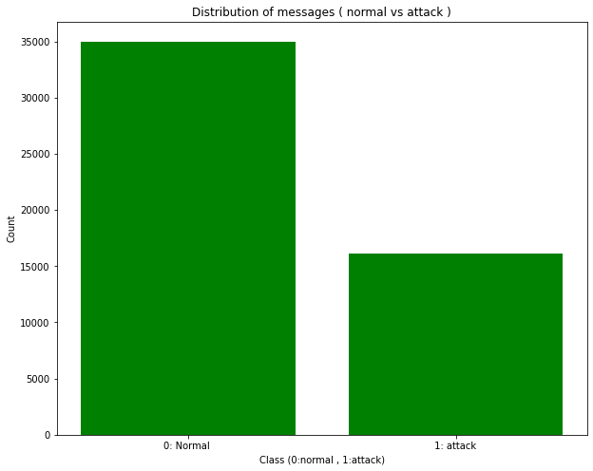
Normal vs Attack distribution

Slide 6
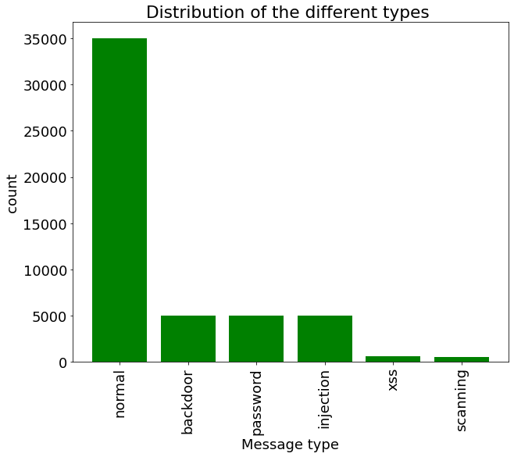
Normal and Attacks distribution

Slide 7
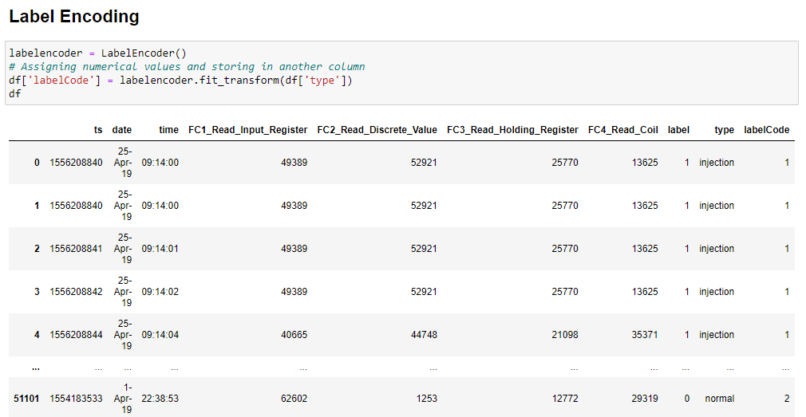
Label encoding the target variable (type)

Slide 8
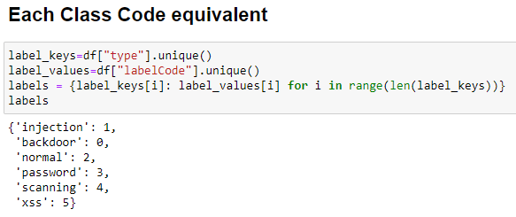
Each class code equivalent

Slide 9
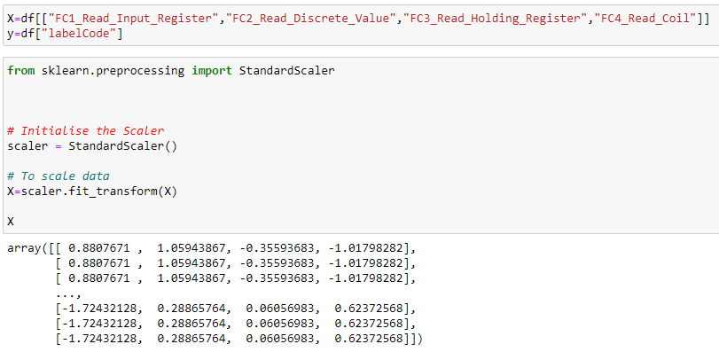
Feature selection + scaling

Slide 10
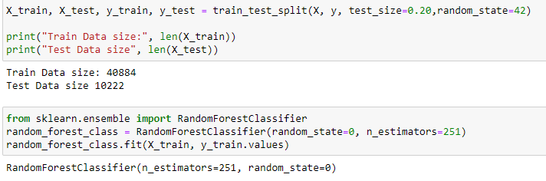
Data splitting and model training ( Random Forrest)

Slide 11
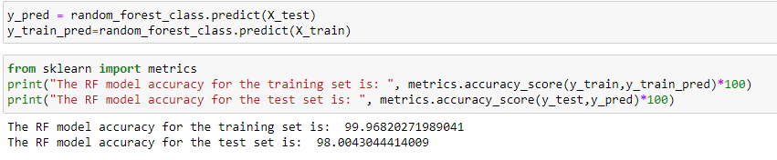
Prediction and accuracy metric

Slide 12
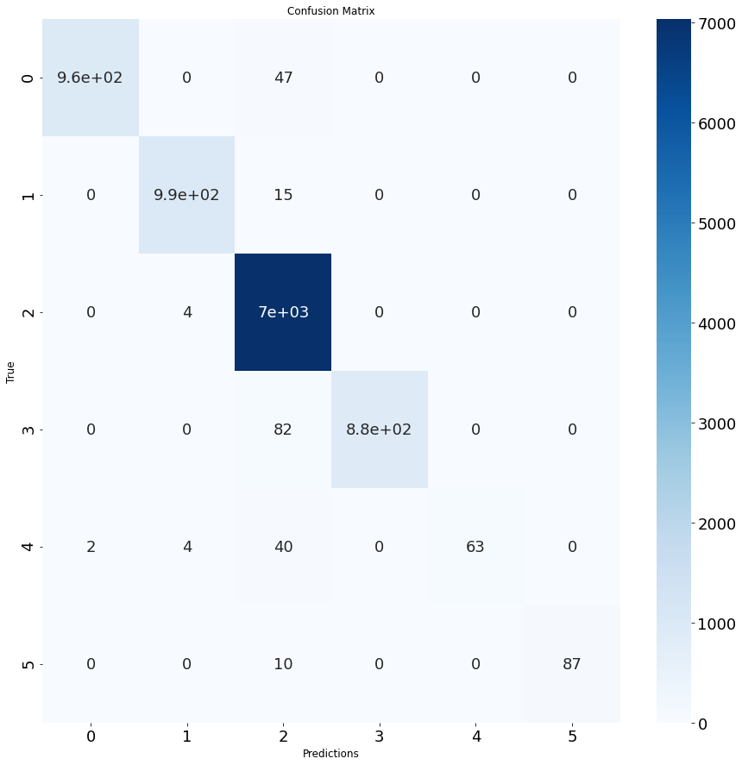
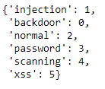
Confusion matrix

Slide 13
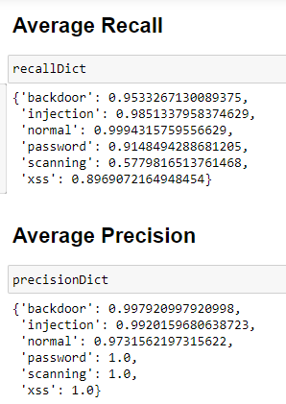
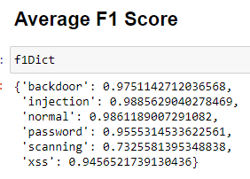
Recall, Precision, F1 score

Slide 14
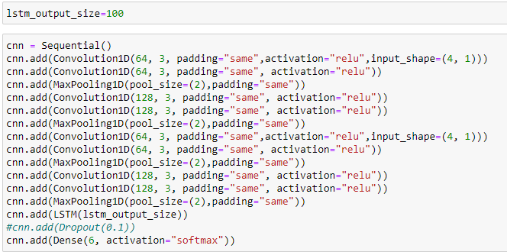
1D CNN LSTM model

Slide 15
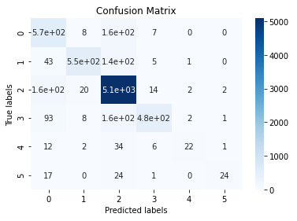
Train and Test accuracy + Confusion Matrix
Train accuracy: 90,99 % < 99,96 Test accuracy: 88,84 % < 98%

Slide 16
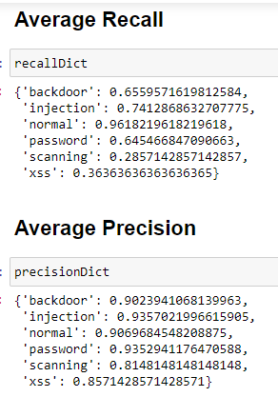
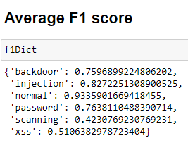
Recall, Precision, F1 score

Slide 17
Conclusion
The Random Forrest model had better results than the 1D CNN LSTM model in terms of :
Test accuracy (98% vs 88%)
recall
precision
F1 score

Slide 18
Decision Tree + Naive Bayes
 | Train accuracy | Test accuracy
Decision Tree | 99,97 % | 97,99 %
Naive Bayes | 68,4 % | 68,84 %

Slide 19
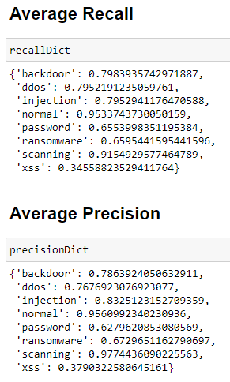
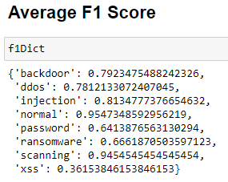
Recall, Precision, F1 score (Decision Tree)

Slide 20
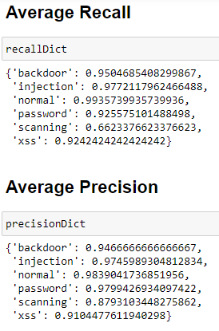
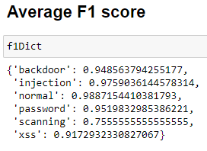
1D CNN model
Train accuracy : 99,44 % | Test accuracy: 97,73 %

